Slide 1

Gender Recognition Using Voice
By,
VARUNA G M

Slide 2
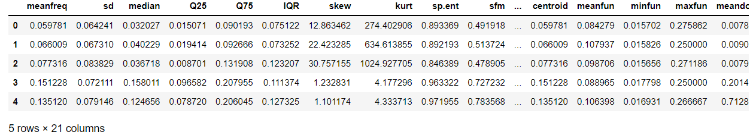
Import Libraries
import pandas as pd
import numpy as np
import matplotlib.pyplot as plt
import seaborn as sns
Load the Data
df=pd.read_csv('C:/Users/RDX/Desktop/Varun/Machine Learning/Kaggle Projects/voice.csv')
df.head()

Slide 3
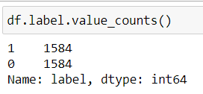
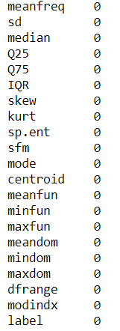
Dataset Description: The goal is to classify the gender based on the voice features The dataset contains 21 columns including 20 attributes and 1 target values which is the gender The Dimensions of the dataset are 3167x21
df.isnull().sum()

Slide 4
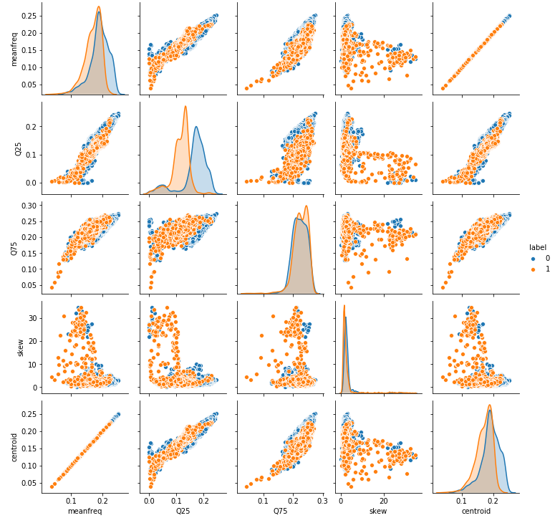
Data Visualization
sns.pairplot(df[['meanfreq', 'Q25', 'Q75', 'skew', 'centroid', 'label']], hue='label', size=2)
plt.show()
This pairplot is plotted to show the relations between the dataset features and we find that the skewness with the quartiles are having a weak relation unlike the meanfreq with the centroid as they have a strong relation.

Slide 5
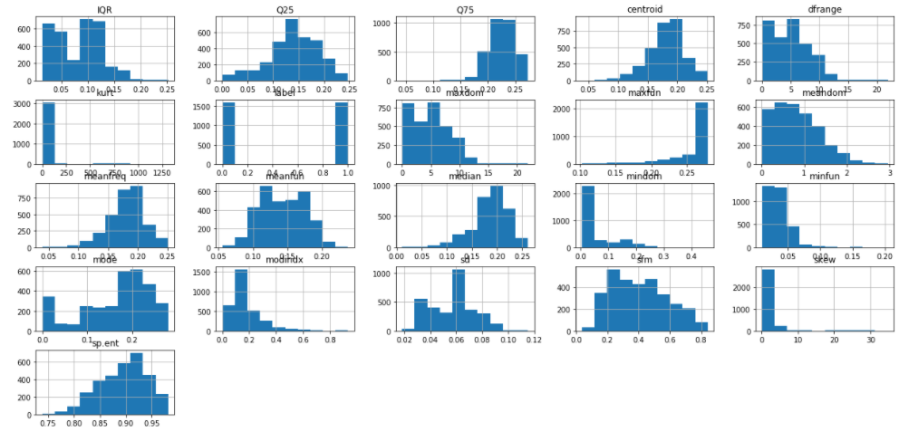
Histogram
df.hist(figsize=(21, 10))
plt.show()

Slide 6
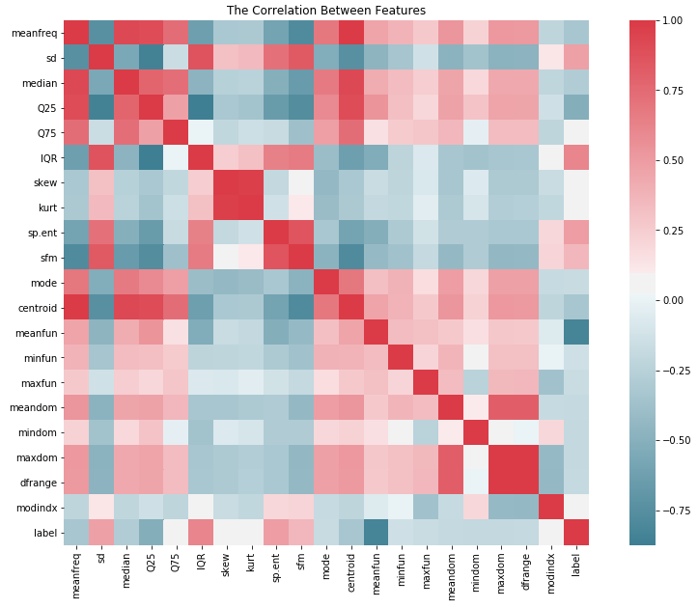
Check the Correlation
f, ax = plt.subplots(figsize=(15, 10))
corr = df.corr()
sns.heatmap(corr,mask=np.zeros_like(corr, dtype=np.bool), cmap=sns.diverging_palette(220, 10, as_cmap=True),square=True, ax=ax)
plt.title('The Correlation Between Features')
plt.show()
This Heatmap shows the correlations between the features; and by looking at it we find a positive correlation between the label and IQR, label and sp.ent, and a huge negative correlation between the label and meanfun

Slide 7

PCA
#The amount of variance that each PC explains
var= pca.explained_variance_ratio_
var
from sklearn.preprocessing import scale
from sklearn.preprocessing import StandardScaler
from sklearn.decomposition import PCA
#Scaling the values
x = scale(X)

Slide 8
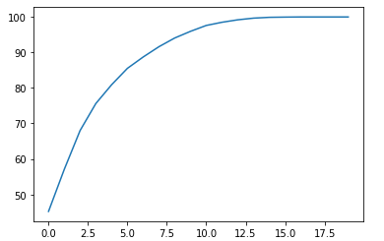
PCA
var1=np.cumsum(np.round(pca.explained_variance_ratio_,decimals=4)*100)
var1
plt.plot(var1)
from sklearn.preprocessing import scale
from sklearn.preprocessing import StandardScaler
from sklearn.decomposition import PCA
#Scaling the values
x = scale(X)

Slide 9

Model Building using Logistic regression
model= LogisticRegression(solver='liblinear')
model.fit(x_train,y_train)
print('Coefficient of model :', model.coef_)
print('Intercept of model',model.intercept_)

Slide 10
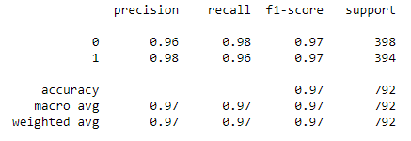
Model Building using Logistic regression
#finding prediction of response variable
ypred = model.predict(x_test)
print(classification_report(y_test,ypred))

Slide 11
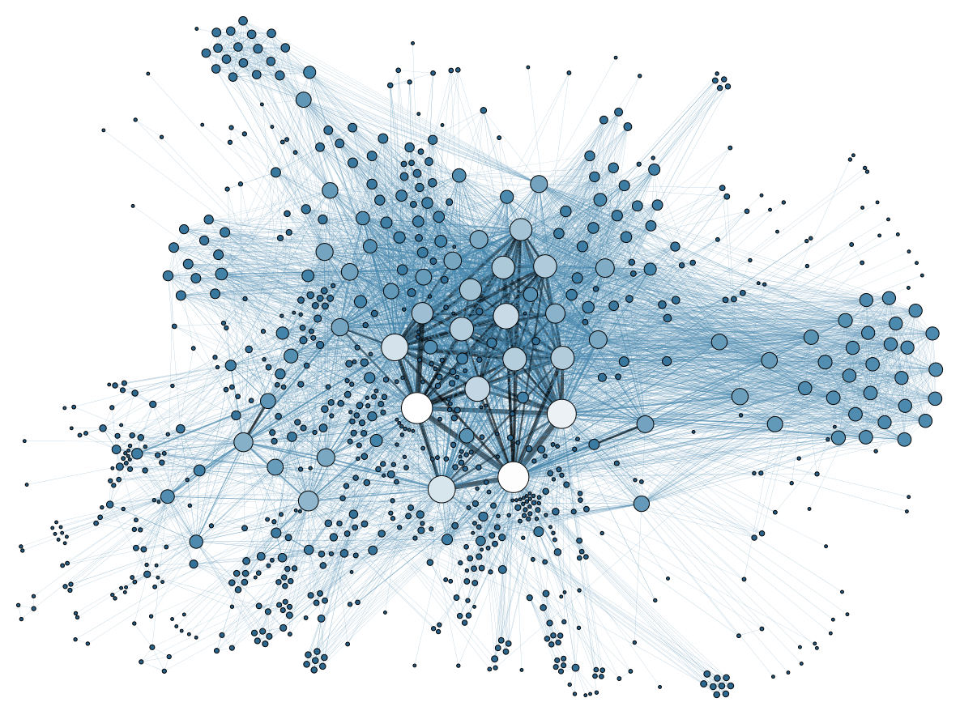
THANK YOU

